Slide 1
Learning About Volcanoes and Mathematics
Soledad Ulep & Eligio Obille Jr
U.P. NISMED, Philippines

Slide 2
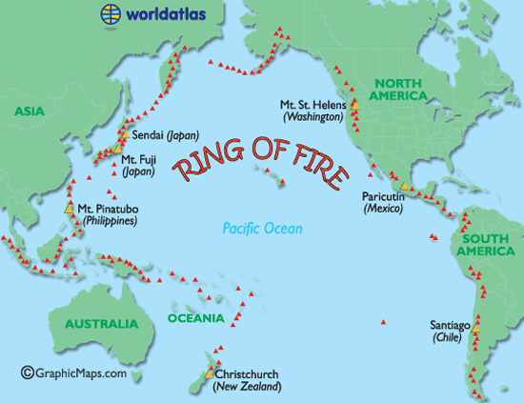
Most of the active volcanoes in the world are found around the Pacific Ocean.
http://www.worldatlas.com/aatlas/infopage/ringfire.htm

Slide 3
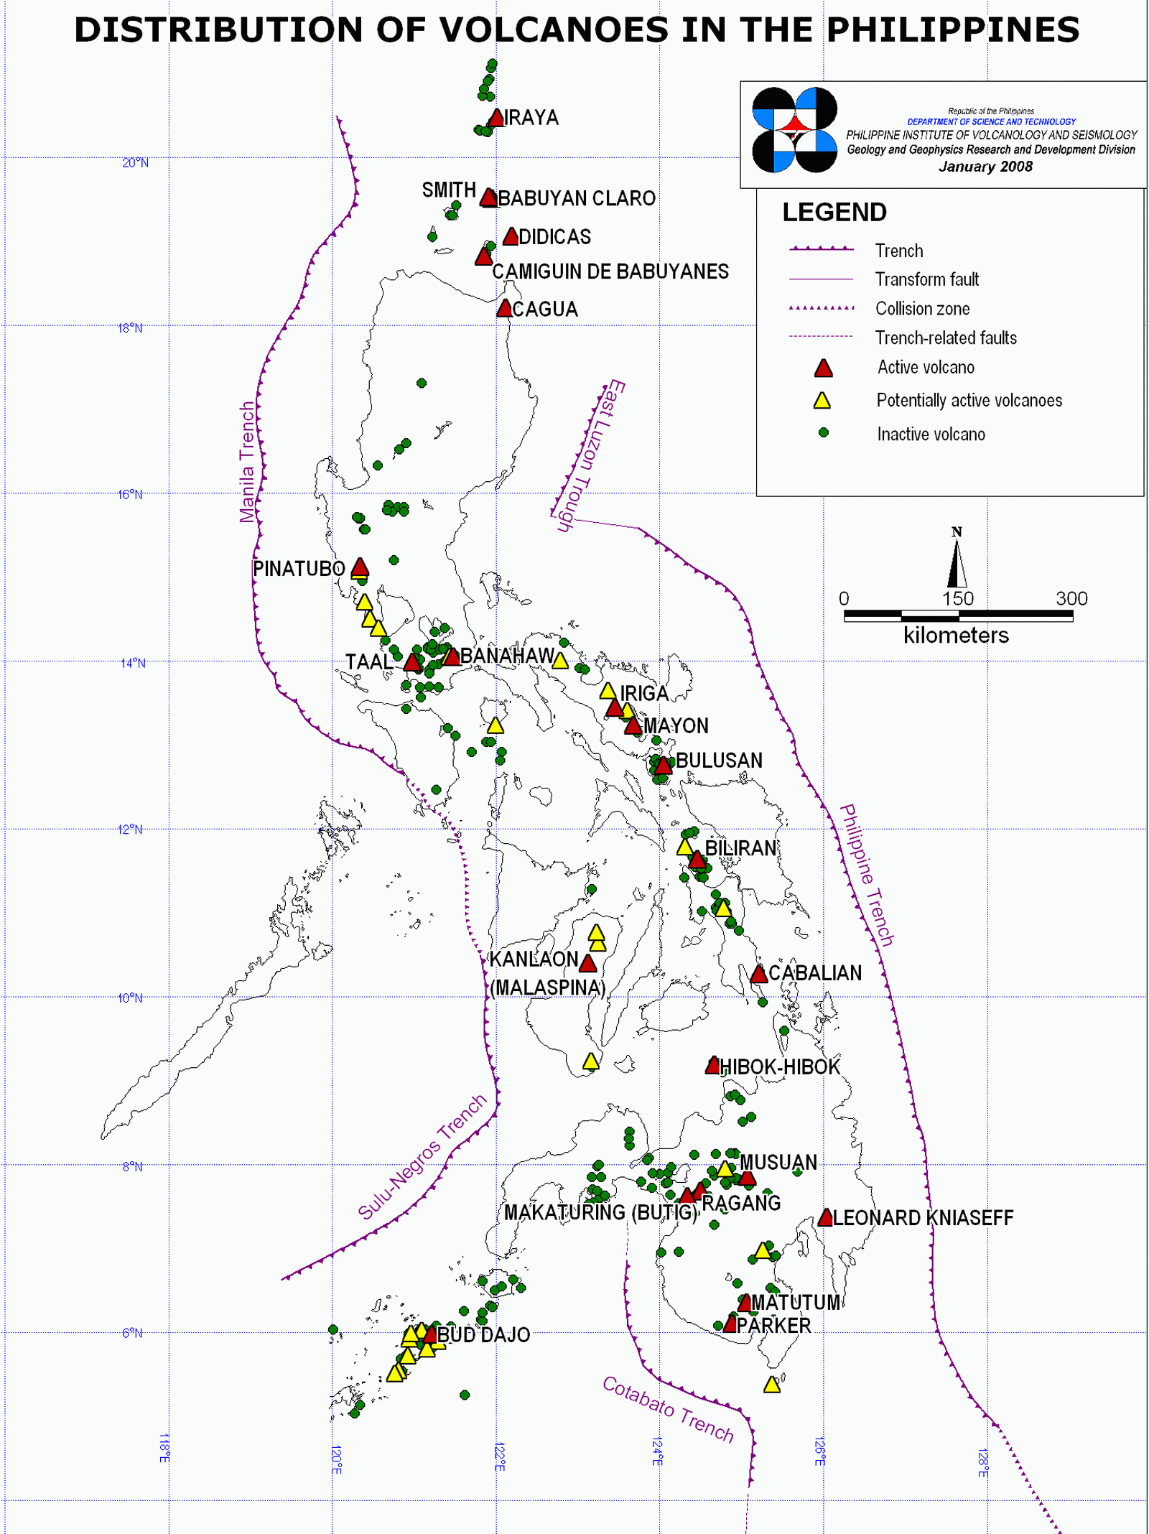
Philippine Institute of Volcanology and Seismology

Slide 4
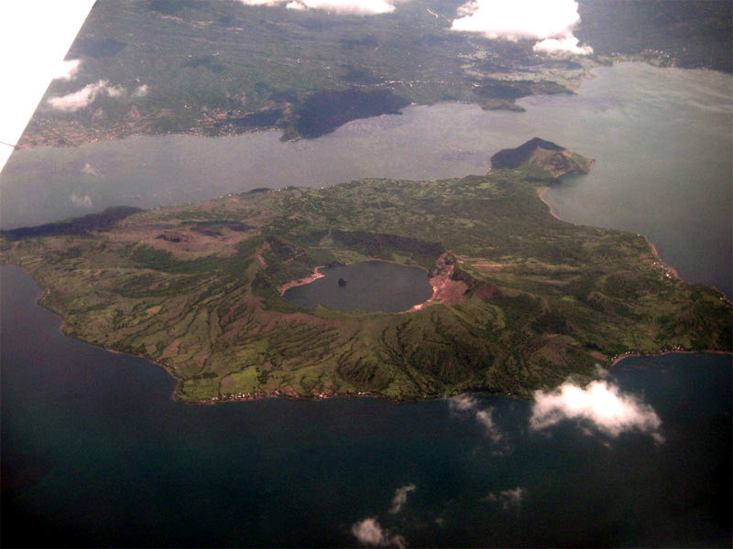
Taal Volcano

Slide 5
Crater Lake, Taal Volcano Photo: E. Obille Jr.

Slide 6
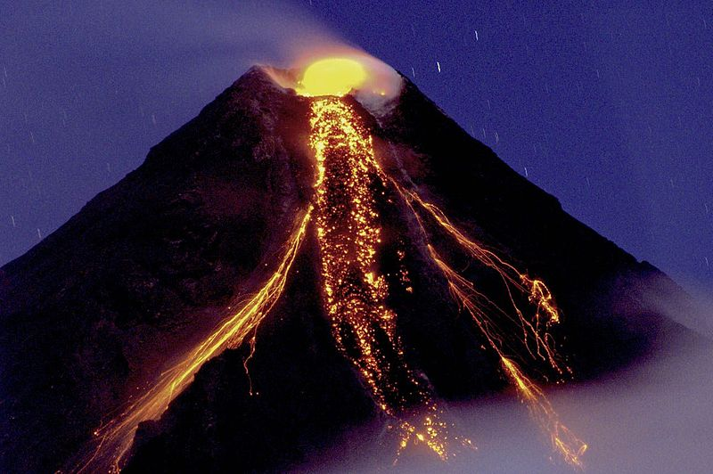
When volcanoes erupt, different materials come out.
Lava eruption at Mayon Volcano Photo: Tryfon Topalidis

Slide 7
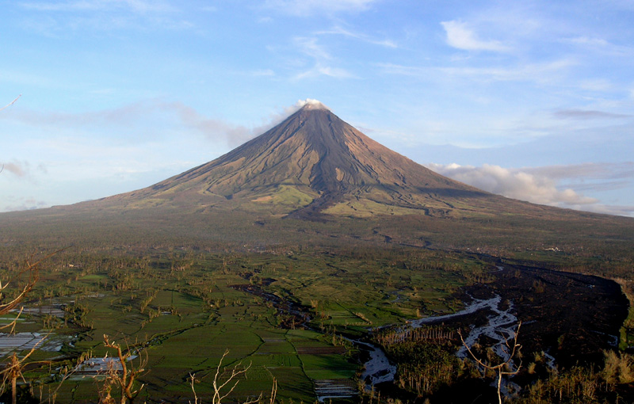
Lava flow at Mayon Volcano Photo: Tomas Tam

Slide 8
Later on, the lava cools down and turns solid.

Slide 9
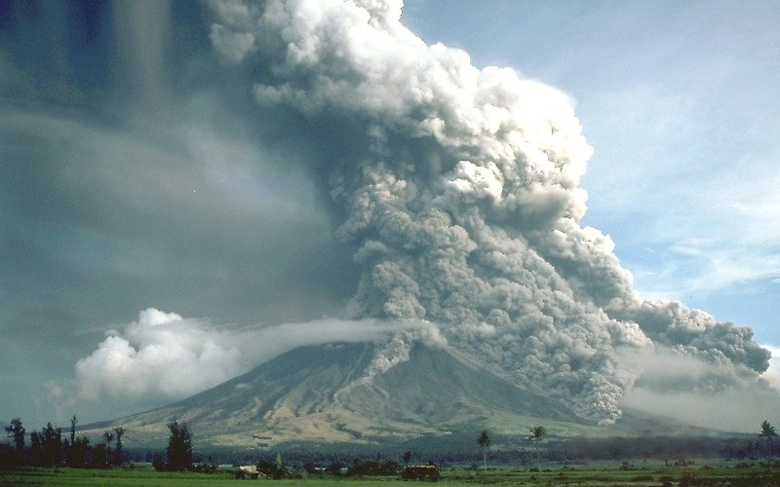
Very small fragments that come out of volcanoes are called ASH.
Pyroclastic flow at Mayon Volcano Photo: C.G. Newhall

Slide 10
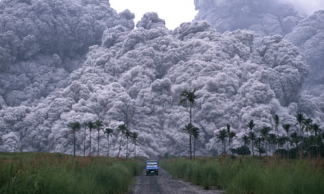
Pyroclastic flow at Pinatubo Volcano Photo: Alberto Garcia

Slide 11
The volcanic ash that fall on the slopes of a volcano may become saturated with rain during typhoon season. Later, the ash and rainwater mixture may move down as LAHARS.

Slide 12
Notes:
Photo shows Mt Pinatubo (center) as seen from above. Gray materials are lahars, moving down the slopes of the volcano along river channels toward lower areas.

Slide 13
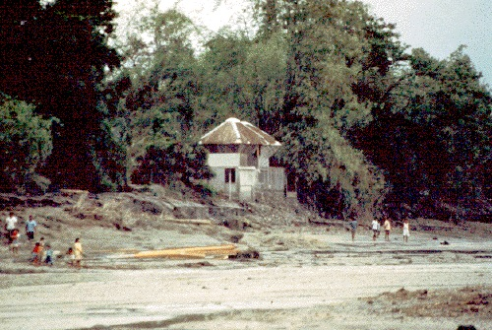
Before lahar event Photo: in Fire & Mud, Newhall and Punongbayan, eds

Slide 14
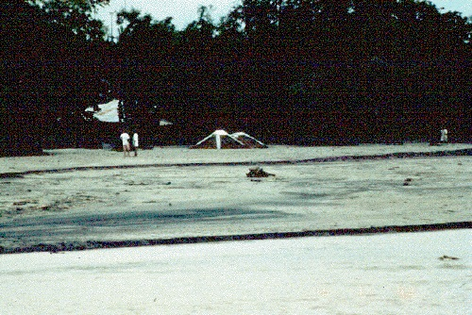
After lahar event Photo: in Fire & Mud, Newhall and Punongbayan, eds

Slide 15
Notes:
Lahars of Mt Pinatubo bury the surrounding areas after the 1991 eruption

Slide 16
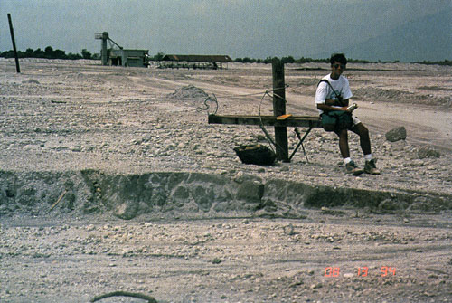
Lahar in Pampanga Photo: in Fire & Mud, Newhall and Punongbayan, eds

Slide 17
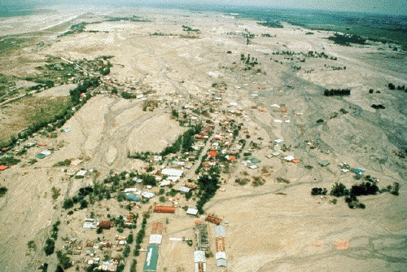
Lahar in Tarlac Photo: in Fire & Mud, Newhall and Punongbayan, eds

Slide 18
Lahars at Mayon Photo: E. Obille Jr.

Slide 19
Lahars at Mayon Photo: E. Obille Jr.

Slide 20
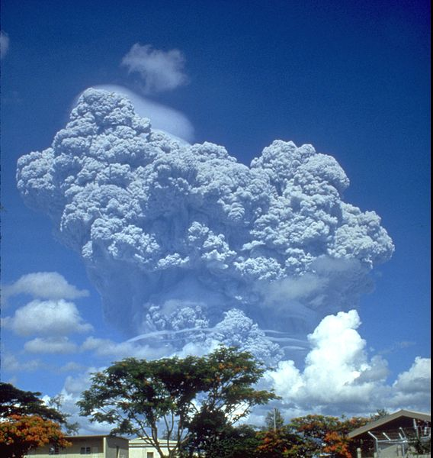
Pinatubo eruption, 1991 Photo: Richard P. Hoblitt, USGS

Slide 21
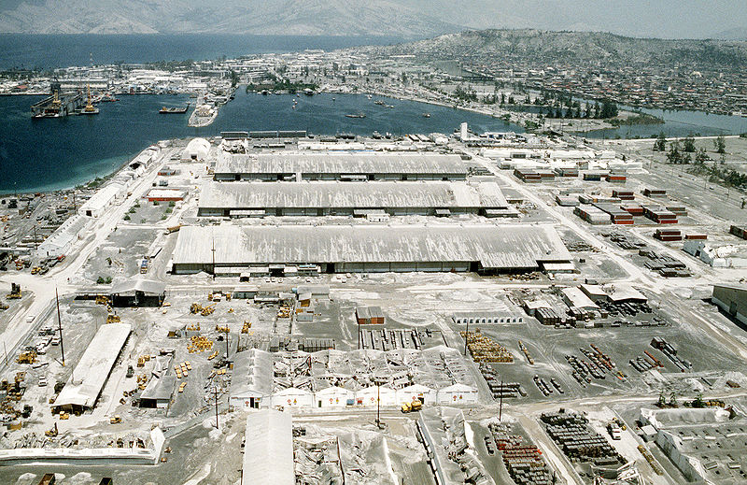
Pinatubo ashfall Photo: United States Marine Corps

Slide 22
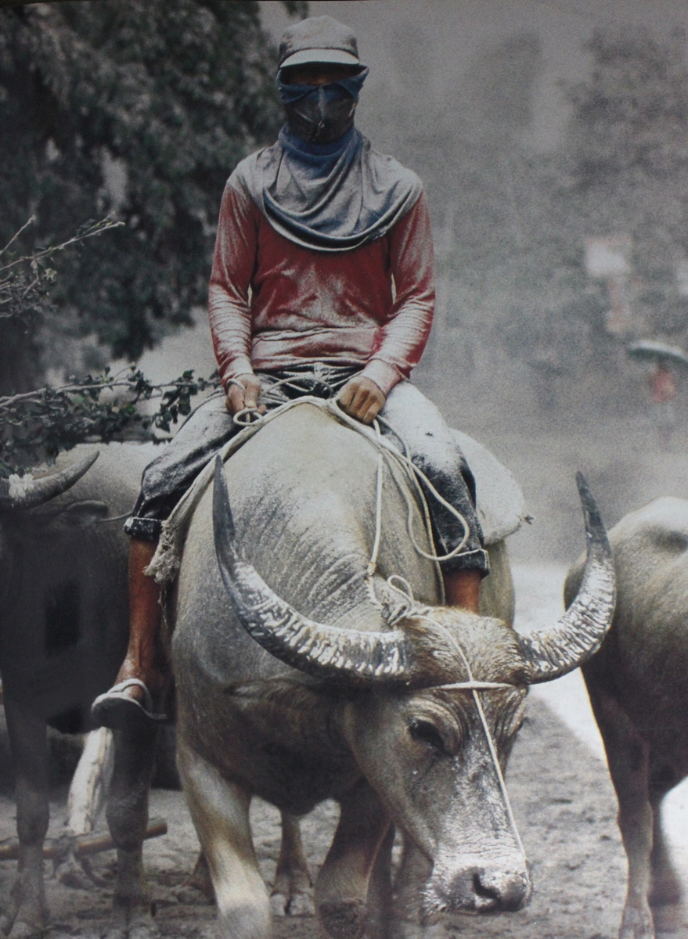
Notes:
People evacuate during the Mt Pinatubo eruption in 1991.

Slide 23
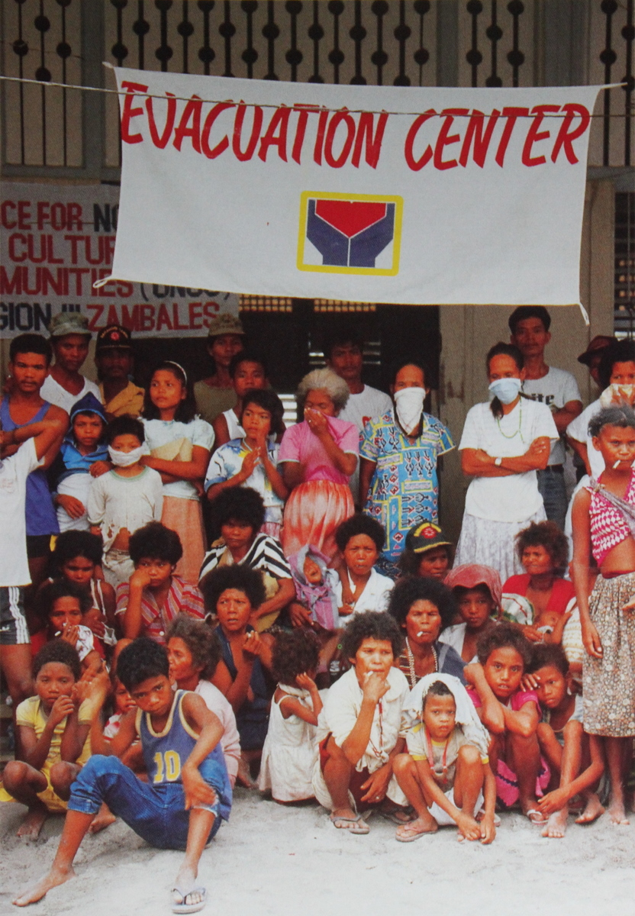
Notes:
People flee to evacuation centers during the Mt Pinatubo eruption of 1991.

Slide 24
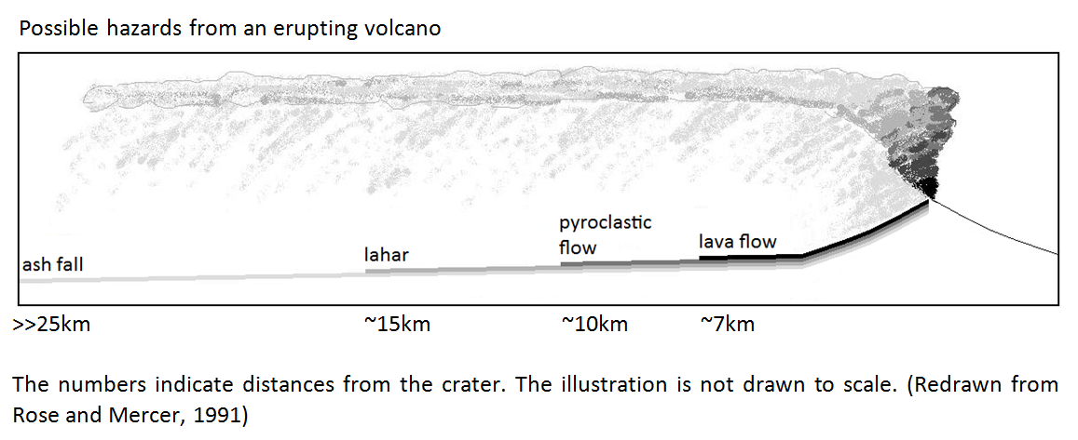

Slide 25
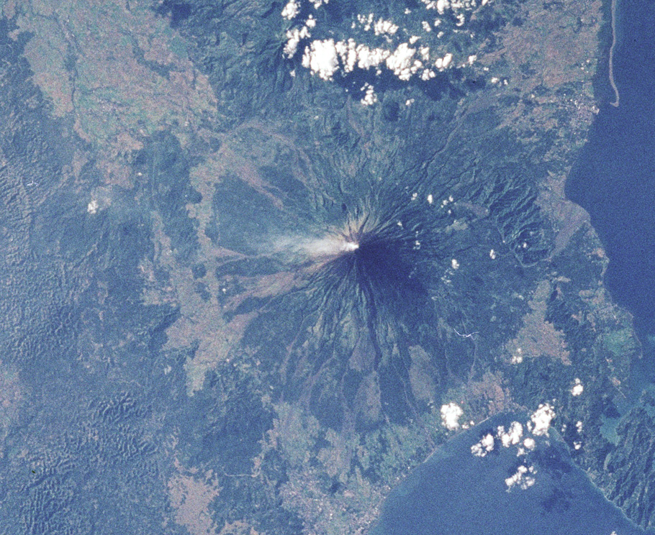
Mayon Volcano, Albay Photo: NASA

Slide 26
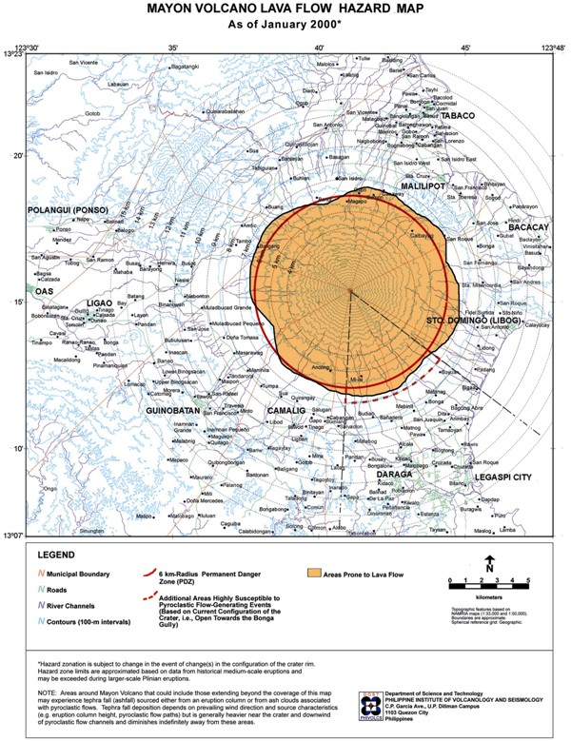

Slide 27
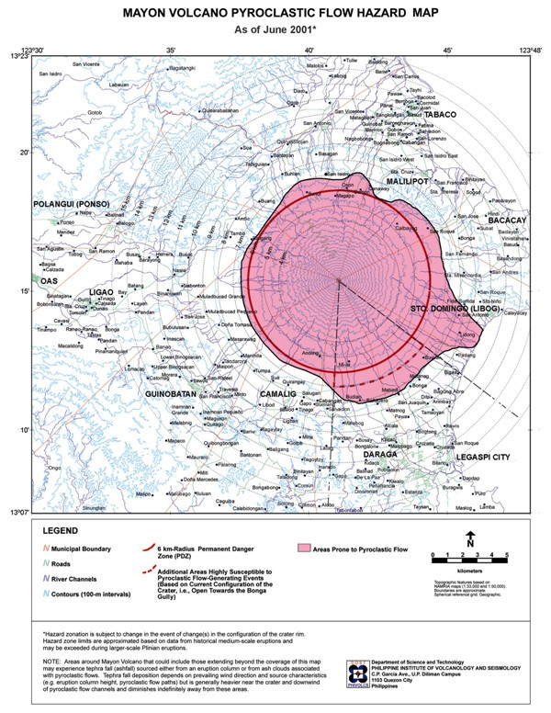

Slide 28
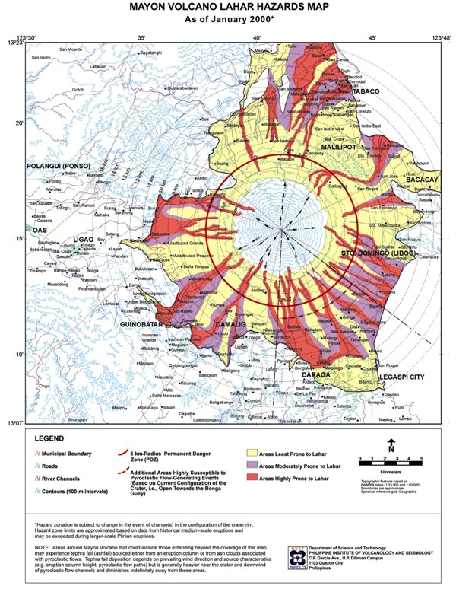

Slide 29
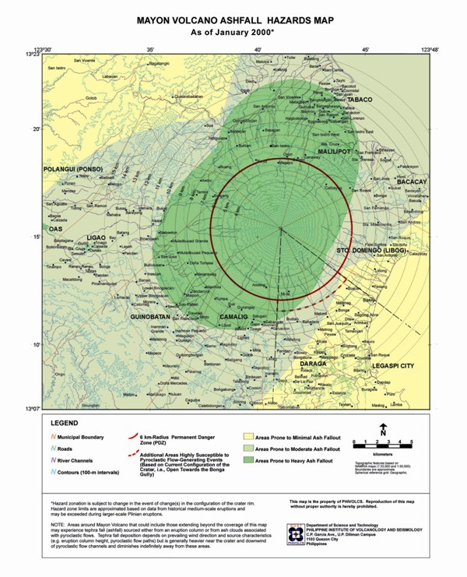

Slide 30
Suggested Mathematical Tasks
Determine the distance of the community from the volcano using a map.
Determine the distance travelled by different volcanic materials (deposits made by lavas, pyroclastic flows, ashfall, and lahars (students will use hazard maps as basis)
Compare the relative speeds of the different volcanic hazards (lava flow, pyroclastic flow, lahars, ashfall) with the “speed” of walking, running, bicycling, or using a car.

Slide 31
Suggested Mathematical Tasks
Determine the area covered by the different volcanic deposits (to help students visualize the extent of this area, compare it to that of a basketball court)
Determine the volume of materials ejected by a volcano (to help students visualize the large amount of material involved, compare it to the capacity of a dump truck)

Slide 32
Reference
Newhall, C. G., & Punongbayan, R. S. (Eds.). (1996). Fire and Mud: Eruptions and Lahars of Mount Pinatubo, Philippines. Seattle and London: University of Washington Press. Retrieved August 12, 2005, from http://pubs.usgs.gov/pinatubo/contents.html

